Slide 1
Week 5 - Final Project Presentation
Shun Cai
UAGC CST499
Capstone for Computer Software Technology (CSF2415A)

Slide 2
SRS document
Introduction: outline the OCMS concept
Purpose
Scope
Definitions, Acronms and Abbreviations
System Overview
System Requirement: functional and User registration
Profile Management and User Authentication
Non-Functional Requirements: Performance, Security, Usability and Reliability
Conclusion

Slide 3
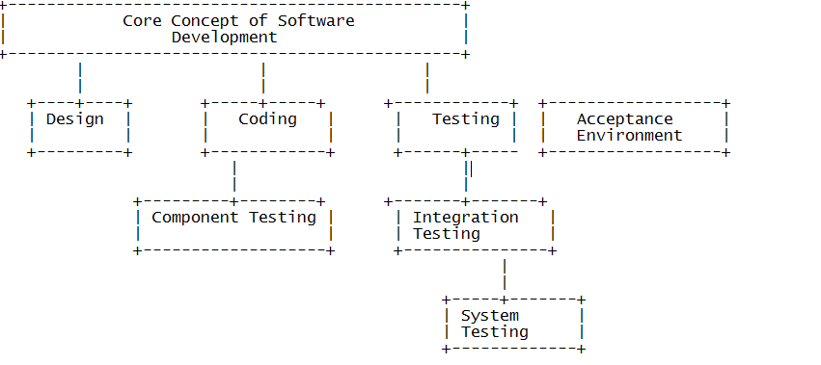
UML Design Model

Slide 4
MySQL, PHP related design of the landing, login and enrollment page
Employee portal website as an example
Home Page, login page, php code etc
Data base creation: MySQL installation
Modify data base: update and delete
Update the database

Slide 5
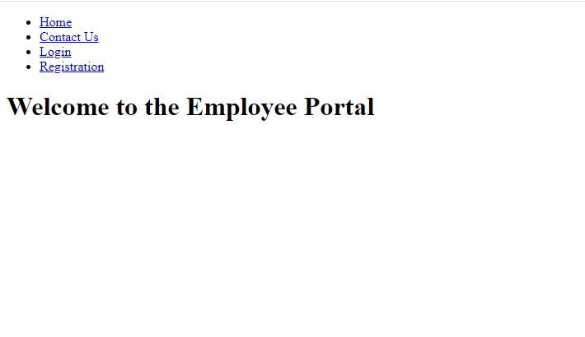
Portal Website Home Page

Slide 6
Example of the home page source code
1. HTML Structure: The code begins with the standard HTML5 document structure, including the `<!DOCTYPE html>` declaration and opening `<html>` tag.
2. Head Section: Inside the `<head>` section, essential meta tags for character encoding and viewport settings are included. Additionally, there's a `<title>` tag to set the title of the web page, and a `<link>` tag is used to link an external CSS stylesheet (assuming it exists).
3. Body Content: The main content of the web page is within the `<body>` section. It consists of a `<header>`, `<nav>`, `<main>`, and `<footer>` sections.
4. Header and Navigation: Inside the `<header>`, there's a `<nav>` element containing an unordered list (`<ul>`) with navigation links (`<a>` tags) for the Home, Contact Us, Login, and Registration pages.
5. Main Content: The `<main>` section contains the main content of the web page, which in this case is a welcoming message (`<h1>`) to the Employee Portal.
6. Footer: The `<footer>` section is reserved for footer content. It's left empty in this code snippet.

Slide 7
Purpose of the Employee Portal Website:
The purpose of the provided code is to create a basic layout for the employee portal website. The layout includes a navigation menu with links to various sections of the portal, such as Home, Contact Us, Login, and Registration. The main content area displays a welcome message to the employee portal users.
The code serves as a starting point for building the front-end of the employee portal website. It provides a clear structure for organizing content and navigation elements, making it easier for users to navigate and interact with the portal. Additionally, it can be extended and customized further with additional features and styling to meet the specific requirements of the employee portal.

Slide 8
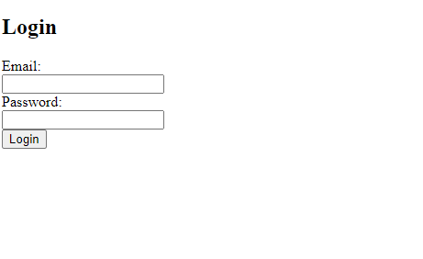
Log in page

Slide 9
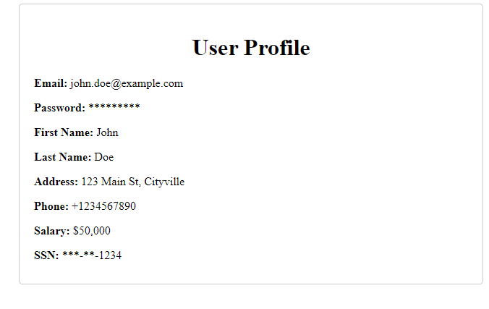
User Profile

Slide 10
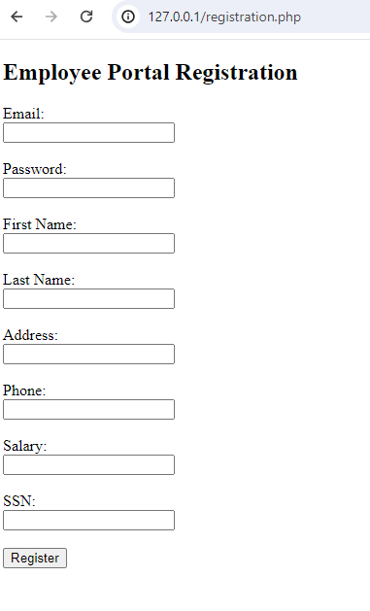
Registration Page

Slide 11
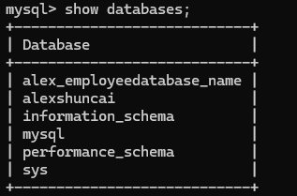
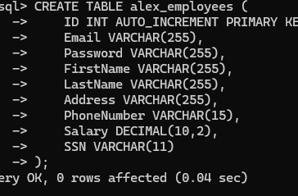
DataBase page
Download SQL
Create database
alex_employeedatabase_name
Establish employee information

Slide 12
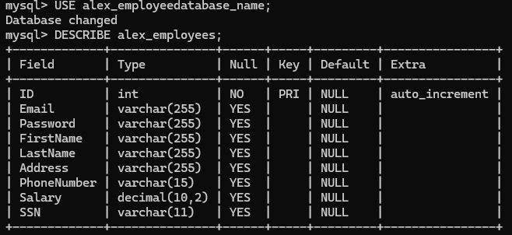
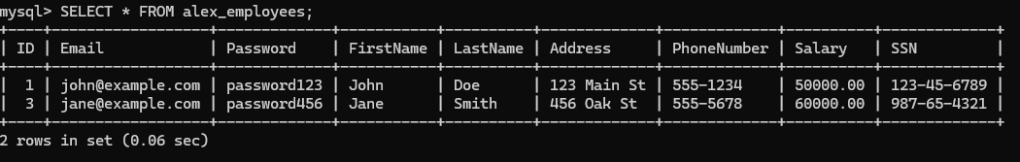
DESCRIBE and display existing employee info

